Slide 1
The effects of urban tolls, low emission zones (and so on)
References certified 100% counterfactual analysis
Lionel Védrine
CESAER, AgroSup, INRA, U. Bourgogne Franche-Comté

Slide 2
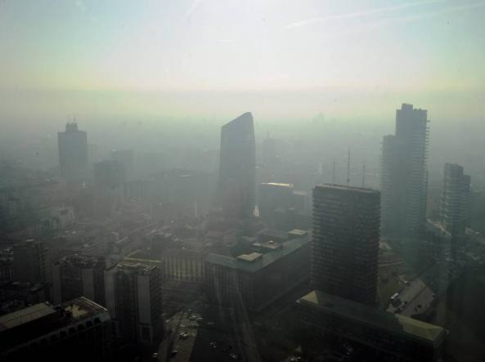
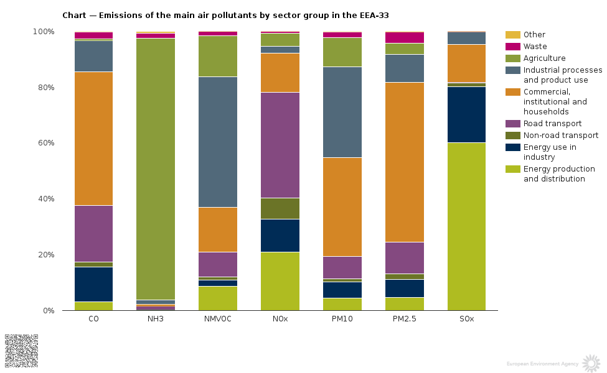
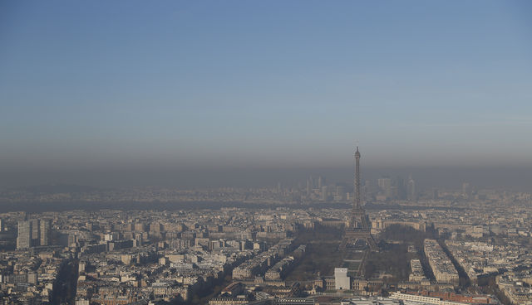
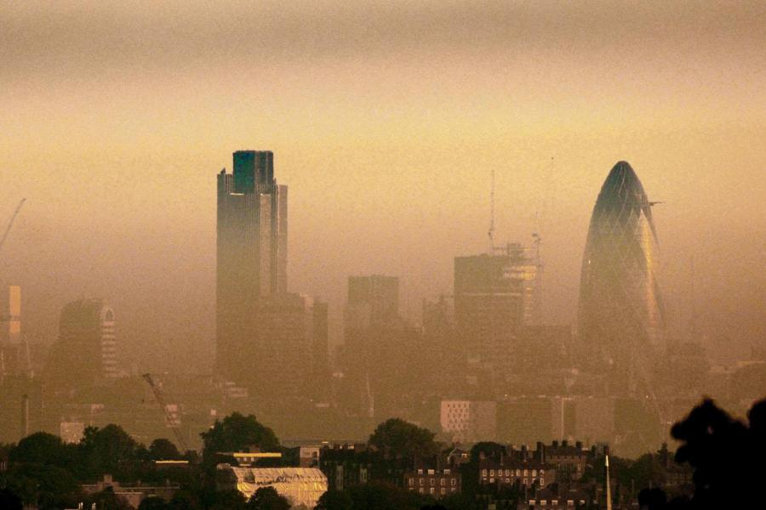
Why regulate traffic related pollution?
Health
Worker productivity
Cognitive capacity
430 000 premature death by year (estimated from 2011 concentrations) in EU-28.
Prenatal exposition affect children development (lung functions, immunology)
Using random allocation of students during exams, Ebestein et al. (2016) find relation between PM2.5 exposure (day of exam) on student scores: from 1.2 pts decline for moderate pollution to 2.25 pts for high pollution.
Using random allocation of soccer player during match, Lischter et al. (2017) finds impact of players’ exposure on their productivities.

Slide 3
How to regulate traffic related pollution?
Driving bans
Prohibit drivers using their cars on given days, depending on the last digit on their number plates.
Complex link between driving decisions and actual emissions
impact of a traffic regulating measure dependant on various factors (speed, km driven, number of trips, fleet composition, driver behavior etc…),
diffuse pollution issue,
we can’t propose a taxation scheme which could tax each driver at the level of its marginal emissions (Fullerton et al., 2002) => Drivers take trips for which social cost exceeds social beneﬁt.
Low emission zones
Prohibit high polluting cars in designated areas.
Indirect policies which target key areas to regulation urban traffic pollution
Speed limit restrictions
Reduce speed limit on specific roads or zones.
Congestion/pollution charge zones
Charge to be paid to drive in a specified zone.

Slide 4
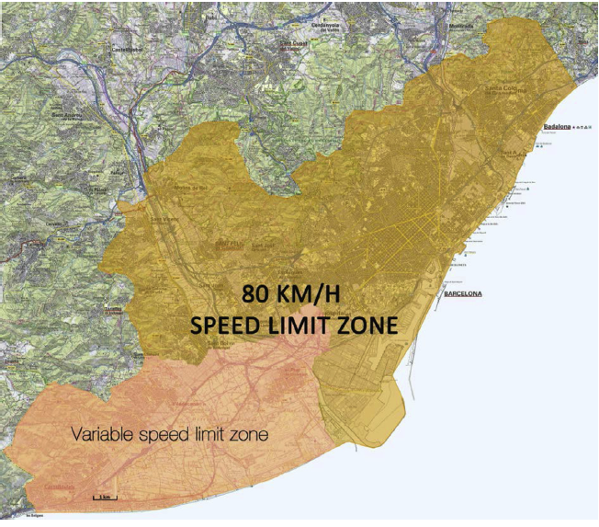
Speed limit restrictions
Two speed management policies in Barcelona:
reduce motorway speed limit from 110 to 80km/h (2008)
a variable speed limit (max 80 km/h) was introduced (2009)
DID => comparing the average changes in air pollution over time(before/after the policy intervention) between the treatment and the control groups and control for weather and traffic for each.
Bel et al. (2013, 2015) use Differences-in-Differences (DID) to study the impact of speed reductions on air pollution concentration levels:
Teatment group composed of monitoring stations inside the speed management zone
Control group compsed by others monitoring station in Catalonia.
Positive effect (increase) in the 80KM/H zone for PM10 et NOX concentrations,
Negative effect (decrease) in the variable speed zone for both PM10 and NOX concentrations
Effect if higher for low concentration of PM10.
No significant effect of low concentration of NOX.

Slide 5
Driving bans
Davies (2008) study the effect of Mexico driving bans using Regression dicontinuity design with high frequencies data:
estimate discontinuities in air pollution concentration days/weeks around the date of implementation.
Mixed evidence on air pollution
Some increasing effects in NOX concentration
Additional result on traffic substitution:
Increase in taxis use in short term,
Second car purchase (more pollutant) in long term.

Slide 6
Low Emission Zone
Wolff (2015) studies the effect of LEZ implementation in Germany on PM10 concentrations
Using several strategy to reconstruct the conterfactuals PM10 concentrations in treated cities:
DID
DID matching on 2005 PM10 concentrations
compares LEZ to nearest Future LEZ
LEZ decrease PM10 concentration by 9% in average.
No spatial spillover (traffic diversion).
Massive effect on vehicle traffic composition.
Heterogeneity across zones => larger LEZ having stronger impacts.

Slide 7
Pollution charge
Gibson and Carnovale (2015) studies the effect of Area C on traffic and pollution
Exploiting natural experiment created by a unanticipated court injunction to suspend Area C.
Traffic increase in the Area C during suspension lead to an 6% decrease in CO and 17% decrease in PM10.

Slide 8
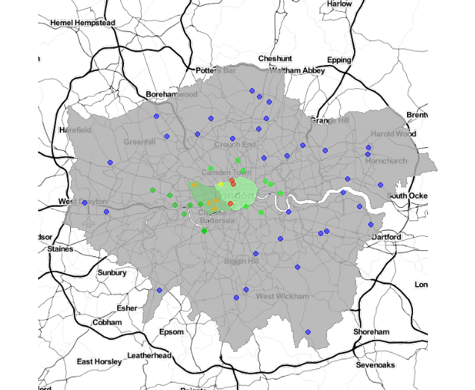
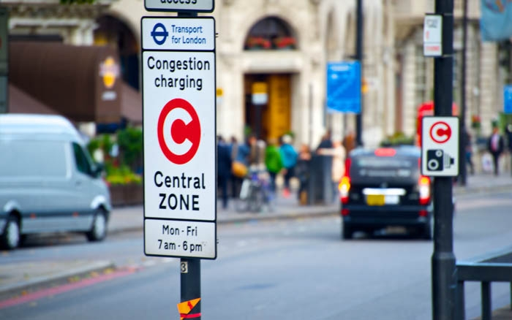
Congestion charge
Legras and Védrine (2017) estimates the effect of London Congestion charge on air quality
The NO2/NOX ratio paradox
A « Porsche Cayenne effect » (new diesel technology doesn’t work well at low speed)
21 km2 (1.4% of Greater London) + western extension (2007-11) of 19km2
We construct a specific counterfactual for each monitoring station inside the zone and for several pollutants, using synthetic control:
Synthetic control station estimated as the weighted average of control stations that mimics as closely as possible air pollution at the treated before LCC
Long term effects
Control for weather and socio-economic variations
Meaningful reduction of traffic, distance travelled and time lost to congestion in the zone
Substantial revenues raised (140m/y. £) to invest in public transport

Slide 9
Conclusion
Some promizing results of LEZ and Congestion charge zones to reduce PM10 pollution,
  Congestion charge revenue have a beneficial impact on public transport investment,
Cautions with permanent driving bans, but temporary implementation can be effective (e.g. Beijing 2008),
Policy comparisons are difficult (~case studies, different contexts),
  we need more studies of related policies in same contexts (Europe) are to inform this public policy debate better and to evaluate the relative efficiencies of competing policies.
Policy makers are the key players to improve policy evaluation
Think ex-post evalutions needs (e.g. data collection),
or use random experimentation at early stages of these policy project
Interactions between policy markers and researchers are crucial.

Slide 10
Thank you for our attention
contact
lionel.vedrine@inra.fr
A survey on the effectiveness of clean air pollution though traffic regulation (from this presentation material) will be published soon (end to October) on lionelvedrine.wordpress.com

